Slide 1


Fundamentals of RM
RM System and Process
Leadership in RM
Incident Investigation
RM Tools & Challenges
RM in Industry
People & Org.
Application and Perspectives
On Becoming a Leader
in Risk Management
ENGG404 – Seminar #4
Chapter 4.6: Tools to Develop and Prioritize Recommendations
1

Slide 2
Learning Outcomes:
Check that recommendations address/eliminate latent causes.
Generate and prioritize recommendations for action.
Chapter 4.6: Tools to Develop & Prioritize Recommendations
2
Notes:
2

Slide 3
Developing Key Recommendations:
Any incident investigation / root cause analysis (your team project) will generate many possible risk reduction solutions.
Management (you) must carefully evaluate these ideas in order to determine which ones are practicable, can be effectively implemented, and be effective when implemented.
Your recommendations should be SMART: specific, measurable, actionable, realistic, and timely.
The process consists of these major steps:
  Generate the Preliminary Recommendations.
  Characterize and Prioritize the Recommendations.
  Do a “Reality Check”.
  Document the Recommendations.
  Summarize the Recommendations.
How do you prioritize?
1)-3) are a “work in progress”
Chapter 4.6: Tools to Develop & Prioritize Recommendations
3
Notes:
3
So what is the work process for creating recommendations? How do you get it done?
Prioritize using a simple or complex effort vs gain evaluation
Reality check: Is this do-able?

Slide 4
Prioritizing:
Which recommendations will you implement?
Which order will you implement them?
CONSIDER:
(See the glossary for a
discussion on “practicable”.)
Useful & Feasible
Practicable
Effective Once Implemented
Can be Successfully Implemented
Chapter 4.6: Tools to Develop & Prioritize Recommendations
4
Notes:
4
Challenge is finding the sweet spot!
Risk reduction solutions generated 30 to 40 from your team projects!
Practicable – useful and feasible

Slide 5
The Best Risk Reduction Solutions Are Those That Are:
Easiest to Implement
Lowest Cost to Implement
Quickest to Implement
Addresses Latent Causes
The recommendations to address latent causes must be most useful, feasible, and effective.
Chapter 4.6: Tools to Develop & Prioritize Recommendations
5
Notes:
5
What is the value of prioritizing recommendations?
Need to work on all of the recommendations made from a RCA, but you have to prioritize how and when you implement them
MUST be practicable and reduce the risk!

Slide 6
Method #1: The Effort v Gain Tool for Quickly Prioritizing Actions
EFFORT Factor:
Generally, want solutions
with the lowest effort:
Simple or Known Technology
Low Effort
Short Duration
Low Cost
Quick to Implement
Chapter 4.6: Tools to Develop & Prioritize Recommendations
6
Notes:
6
How much effort is required to implement and what will you gain?
Gain: Will it address latent causes or only the basic and immediate causes?
If the cost is high, the priority goes down

Slide 7
Method #1: The Effort v Gain Tool for Quickly Prioritizing Actions
GAIN Factor:
Generally want solutions
that reduce risks,
but most importantly,
solutions that address
latent causes.
Solutions are needed that
can and do address
immediate and basic
causes, but the MOST
effective address latent causes.
Address Latent Causes
Most Gain
Reduce Risks
Chapter 4.6: Tools to Develop & Prioritize Recommendations
7
Notes:
7
Gain: Will it address latent causes or only the basic and immediate causes?
Gain refers to:
The effectiveness of the solutions in addressing the causes (reducing the risk). The solution that addresses latent causes is more effective than a solution that addresses basic causes or immediate causes.
Use of Experts: Typically, the persons with expertise and knowledge of the incident, the technology, the causes, and the scope and nature of the fix can make the best judgment on the effectiveness of the risk reduction solutions.
What is a better risk reduction strategy to avoid a vehicle collision? Drive more carefully or get snow tires. Get snow tires is the better solution.

Slide 8
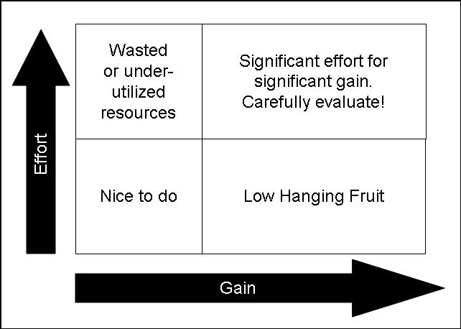
Method #1: the Simple Effort v Gain Illustrated:
You intuitively do this now … would you spend 10 hours on an assignment that’s worth 0.5% of your mark?
Chapter 4.6: Tools to Develop & Prioritize Recommendations
8
Notes:
8
What is the value of prioritizing recommendations?
Need to work on all of the recommendations made from a RCA, but you have to prioritize how and when you implement them
MUST be practicable and reduce the risk!
Challenge is finding the sweet spot!
Risk reduction solutions generated 30 to 40 from your team projects!
Practicable – useful and feasible
How much effort is required to implement and what will you gain?
Gain: Will it address latent causes or only the basic and immediate causes?
If the cost is high, the priority goes down
Simple model. What is this graph saying?
Does everyone understand what the concept of low hanging fruit is? Great gain for minimal effort
Spend 10 hrs working on an assignment that’s worth 0.5%? Wasted resources – lots of effort for little gain
Just because you need to put a lot of effort into something, it doesn’t mean that it’s not worth it (can have major gain, but needs to be analyzed carefully)

Slide 9
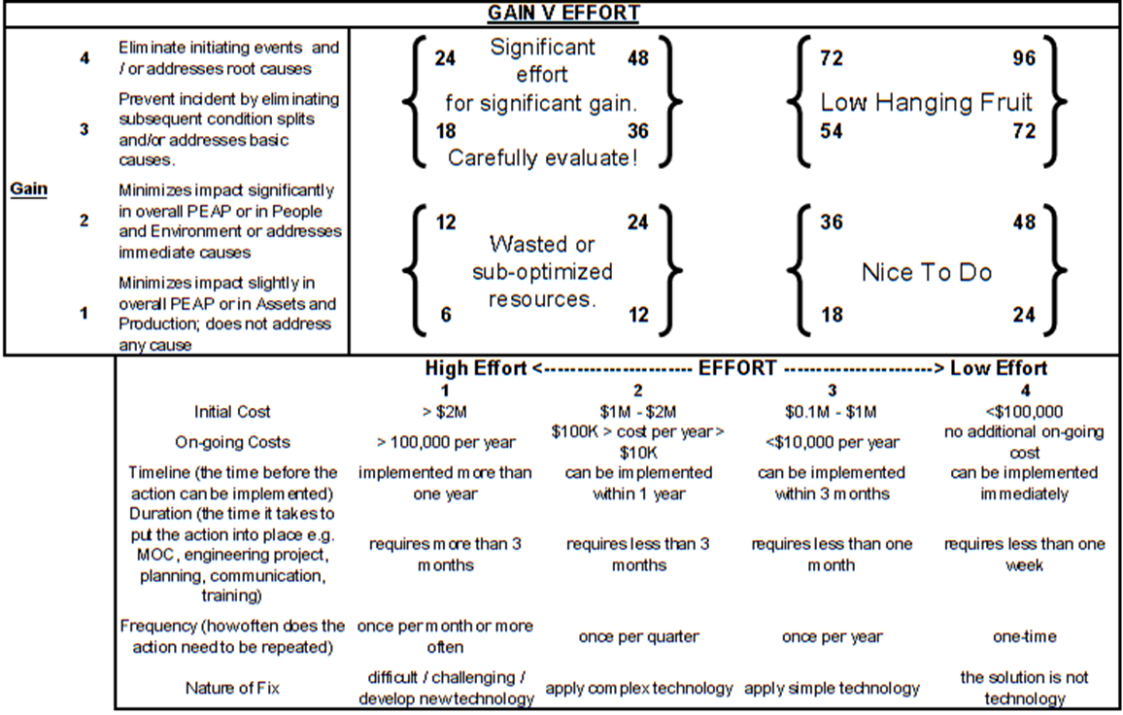
Method #2: The Complex Effort v Gain Tool: “Quantitative”
Chapter 4.6: Tools to Develop & Prioritize Recommendations
9
Notes:
9
The Complex “Effort v Gain” Tool:
More quantitative approach
Gain at the top, effort at the bottom
Add up the points, get a score.
Gain Index: Higher score for addressing latent causes, versus basic and immediate
Effort Index: Similar sort of rating for effort with more categories to consider. Higher score for lower effort

Slide 10
Gain Index of The Complex Tool:
Gain Index | Gain Index Criteria (any one of or combination of):
4 | Addresses latent causes. Eliminates hazards or has the greatest reduction in risk levels. Eliminate initiating events.
3 | Addresses basic causes. Reduces risk levels to a lesser extent than “4”. Prevent incident by eliminating subsequent condition splits. Eliminates impact in overall PEAP despite having an event.
2 | Addresses immediate causes. Reduces risk levels to a lesser extent than “3”. Minimizes impact significantly in overall PEAP i.e. mitigates the consequence of an incident.
1 | Minimizes impact slightly in overall PEAP i.e. mitigates the consequence of an incident. Does not address any cause. Reduces risk levels to a lesser extent than “2”, or not at all.
Chapter 4.6: Tools to Develop & Prioritize Recommendations
10
Notes:
10
Gain Index
Higher score for addressing latent causes, versus basic and immediate

Slide 11
Gain Index of The Complex Tool:
Gain Index | Gain Index Criteria (any one of or combination of):
5 | Addresses latent causes relating to RM Elements #1 MLCA, and/or #6 PECI
4 | Addresses latent causes. Eliminates hazards or has the greatest reduction in risk levels. Eliminate initiating events.
3 | Addresses basic causes. Reduces risk levels to a lesser extent than “4”. Prevent incident by eliminating subsequent condition splits. Eliminates impact in overall PEAP despite having an event.
2 | Addresses immediate causes. Reduces risk levels to a lesser extent than “3”. Minimizes impact significantly in overall PEAP i.e. mitigates the consequence of an incident.
1 | Minimizes impact slightly in overall PEAP i.e. mitigates the consequence of an incident. Does not address any cause. Reduces risk levels to a lesser extent than “2”, or not at all.
You may wish to consider this additional Gain Index criteria in your Team Project!
Chapter 4.6: Tools to Develop & Prioritize Recommendations
11
Notes:
11
Gain Index
Higher score for addressing latent causes, versus basic and immediate

Slide 12
Effort Index of The Complex Tool:
EFFORT INDEX | 1 (high effort) | 2 | 3 | 4 (low effort)
Practicability (how easily the solution can be implemented) | difficult / challenging / develop new technology | apply complex technology | apply simple technology | the solution is not technology
Initial Cost | > $2M | $1M - $2M | $0.1M - $1M | <$100,000
On-going Costs | > 100,000 per year | $100K > cost per year > $10K | <$10,000 per year | no additional on-going cost
Timeline (the time before the action can be implemented) | implemented more than one year | can be implemented within 1 year | can be implemented within 3 months | can be implemented immediately
Duration (the time it takes before the latent cause is addressed) | requires more than 3 months | requires less than 3 months | requires less than one month | requires less than one week
Frequency (how often does the action need to be repeated) | once per month or more often | once per quarter | once per year | one-time
Chapter 4.6: Tools to Develop & Prioritize Recommendations
12
Notes:
12
Similar sort of rating for effort
Higher score for lower effort
Categories - listed

Slide 13
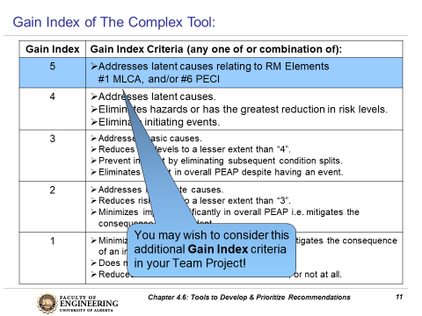
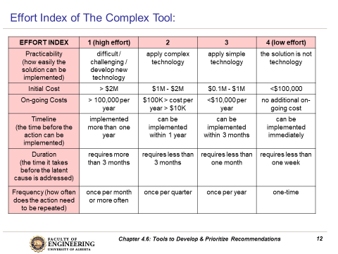
ALE #1: Changing Criteria on the Complex Tool
Please confer (pen-to-paper, MM-Poll):
You saw how the criteria for the Gain Index can be changed.
Can you change criteria on the Effort Index? If so, how might you change those parameters?
Chapter 4.6: Tools to Develop & Prioritize Recommendations
13
Notes:
13

Slide 14
ALE #2: Employee Training Program
Please confer and respond on MM-Poll:
Consider the risk reduction solution.
Gain: … the action addresses a latent cause
Effort: … the effort is characterized by the bold items below
What is the total score?
EFFORT INDEX | 1 (high effort) | 2 | 3 | 4 (low effort)
Practicability | difficult / challenging / develop new technology | apply complex technology | apply simple technology | the solution is not technology
Initial Cost | > $2M | $1M - $2M | $0.1M - $1M | <$100,000
On-going Costs | > 100,000 per year | $100K > cost per year > $10K | <$10,000 per year | no additional on-going cost
Timeline (the time before the action can be implemented) | implemented more than one year | can be implemented within 1 year | can be implemented within 3 months | can be implemented immediately
Duration (the time it takes to put the action into place e.g. MOC, engineering project, planning, communication, training) | requires more than 3 months | requires less than 3 months | requires less than one month | requires less than one week
Frequency (how often does the action need to be repeated) | once per month or more often | once per quarter | once per year | one-time
Chapter 4.6: Tools to Develop & Prioritize Recommendations
14
Notes:
14
Example of the complex tool (quantitative)
4 is from the gain index (4 x 72)
Spend a bit of time on explaining this…

Slide 15
Example: Employee Training Program
Consider the risk reduction solution.
Gain: “4: Addresses latent causes” or “5” per modified Gain Index
Effort: score of 18 (4+3+3+4+1+3)
The total score: 72 = 4 x 18 OR 5 x 18 = 90
The higher the score, the better!
EFFORT INDEX | 1 (high effort) | 2 | 3 | 4 (low effort)
Practicability | difficult / challenging / develop new technology | apply complex technology | apply simple technology | the solution is not technology
Initial Cost | > $2M | $1M - $2M | $0.1M - $1M | <$100,000
On-going Costs | > 100,000 per year | $100K > cost per year > $10K | <$10,000 per year | no additional on-going cost
Timeline (the time before the action can be implemented) | implemented more than one year | can be implemented within 1 year | can be implemented within 3 months | can be implemented immediately
Duration (the time it takes to put the action into place e.g. MOC, engineering project, planning, communication, training) | requires more than 3 months | requires less than 3 months | requires less than one month | requires less than one week
Frequency (how often does the action need to be repeated) | once per month or more often | once per quarter | once per year | one-time
Chapter 4.6: Tools to Develop & Prioritize Recommendations
15
Notes:
15
Example of the complex tool (quantitative)
4 is from the gain index (4 x 72)
Spend a bit of time on explaining this…
72 is in the low hanging fruit section
Go ahead and implement it.
The higher the score, the better.
The quantitative brackets can be adjusted by your team to meet your needs. Consider the expenditures at the Bakery or on a world-scale mining operation.

Slide 16
Paralysis by Analysis: A Pitfall of Complex Ranking Tools:
Excessive time can be spent trying to accurately and precisely determine the likelihood and consequences.
This can detract from efforts to move forward with solutions.
How do you balance the amount of time you spend accurately and precisely determining the index factors or likelihood and consequences of risk?
Rationally apply a Ranking Tool, and be judicious about the time spent on applying the Ranking Tool.
Of course, the more expensive the solution, the more time and expertise needed to evaluate
“Value Engineering” and “Cost – Benefit Analysis”
These two Methods demonstrate the fundamental approach of many different methods used in industry and governments.
Chapter 4.6: Tools to Develop & Prioritize Recommendations
16
Notes:
16
Too much effort spent trying to get more detail.
But what happens if your scoring from the complex doesn’t rank the recommendation how you think it should be?
Provide a rationale for why you are giving it a higher ranking/priority?

Slide 17
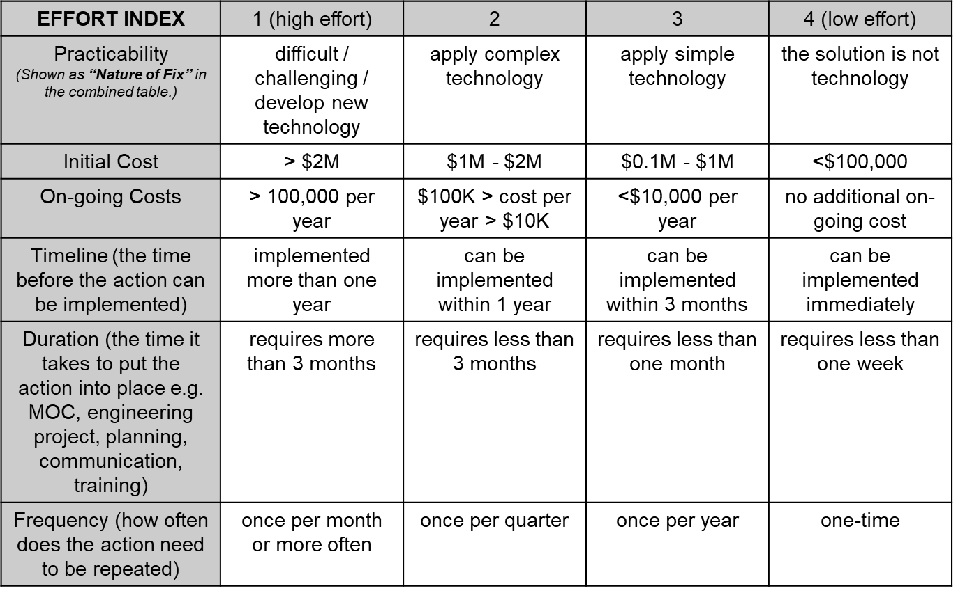
Key Difference Between Hierarchy of Effectiveness & Order of Priority:
Recall: This tool is a hierarchy of effectiveness and yields an order of effectiveness, NOT an order of priority.
Chapter 5.2: The Fundamental Approach to Control All Risks
The Complex Effort vs Gain Tool helps us to prioritize the implementation of recommendations i.e. in what order to we do them.
Chapter 4.6: Tools to Develop & Prioritize Recommendations
17
Notes:
17
I.e. PPE – you prioritize it because it’s easy and cheap, but it is not the most effective risk reduction solution!

Slide 18
Summary on Key Recommendations:
Recommendations are derived from your findings
of the RCA and should address the latent causes!
Recommendations should be: SMART
The work process consists of these major steps:
  Generate the Preliminary Recommendations.
  Prioritize and Characterize Each of
  the Recommendations.
  Here is where you use the
  Complex Effort vs Gain Tool.
  Do a “Reality Check”.
  Document the Recommendations.
  Summarize the Recommendations.
Generate the Preliminary Recommendations.
Prioritize and Characterize the Recommendations.
Do a
“Reality Check”
Document the Recommendations
Summarize the Recommendations
1)-3) are “work in progress”
Chapter 4.6: Tools to Develop & Prioritize Recommendations
18
Notes:
18

Slide 19
Summary and Key Lessons:
There is a difference between “Hierarchy of Effectiveness” and
“Order of Priority”.
The most effective recommendations for actions address or eliminate latent causes, rather than basic or immediate.
Prioritize recommendations for action using the Complex Gain Versus Effort Tool.
Chapter 4.6: Tools to Develop & Prioritize Recommendations
19
Notes:
19

Slide 20
Any questions?
Notes:
20

